Slide 1

PROPERTY • PEOPLE • TRUST
APNA GHAR
भारतीय Real Estate Management System
A role-based platform for property listings, rental applications,
tenancy management and administration.
Admin • Property Manager • Tenant
PROJECT TEAM
Rajat Yadav — Leader | 25scse1011260
Vikram Kumar — Member | 25scse1011290
Dhoni Kumar Singh — Member | 25scse1011292
PROJECT PRESENTATION

Slide 2
01 • PROBLEM STATEMENT
Why a unified real-estate workflow is useful
Three operational gaps the platform is designed to address
Fragmented information
Manual coordination
Limited oversight
Property details, tenant applications, agreements and communication can be scattered across separate tools.
Managers need a clear way to review applications, maintain listing status and respond to tenants.
Administrators need visibility into user roles, listing approvals, settings and platform activity.
Project goal
Bring the core rental lifecycle into one browser-based interface with role-specific views and a consistent workflow.
APNA GHAR • PROJECT PRESENTATION
02 / 12

Slide 3
02 • OBJECTIVES & SCOPE
The prototype demonstrates the main roles and workflows
A centralized interface for property operations and tenancy coordination
Centralize listings
Support tenancy
Enable oversight
Create, search, review and manage property records.
Represent rental applications, agreements and tenant communication.
Provide user management, platform settings and activity views for Admin.
Role-aware navigation
Indian context
Demonstration scope
Admin, Property Manager and Tenant see different dashboards and actions.
Interface uses Indian cities, ₹ currency and India-focused tenancy terminology.
Current project is a React/TypeScript frontend prototype with demo data.
APNA GHAR • PROJECT PRESENTATION
03 / 12

Slide 4
03 • TECHNOLOGY STACK
Technology stack & architecture
Current implementation as represented by the project files
Frontend
UI / state
Persistence status
React + TypeScript components
Vite development server
CSS styling and modal workflows
Role-based dashboard views
Shared React context
Demo data and browser-side state
Frontend state / browser storage patterns
Production backend and database are future work.
ARCHITECTURE FLOW
User / Browser
→
React UI
→
Context + Demo Data
→
Future API + DB
APNA GHAR • PROJECT PRESENTATION
04 / 12

Slide 5
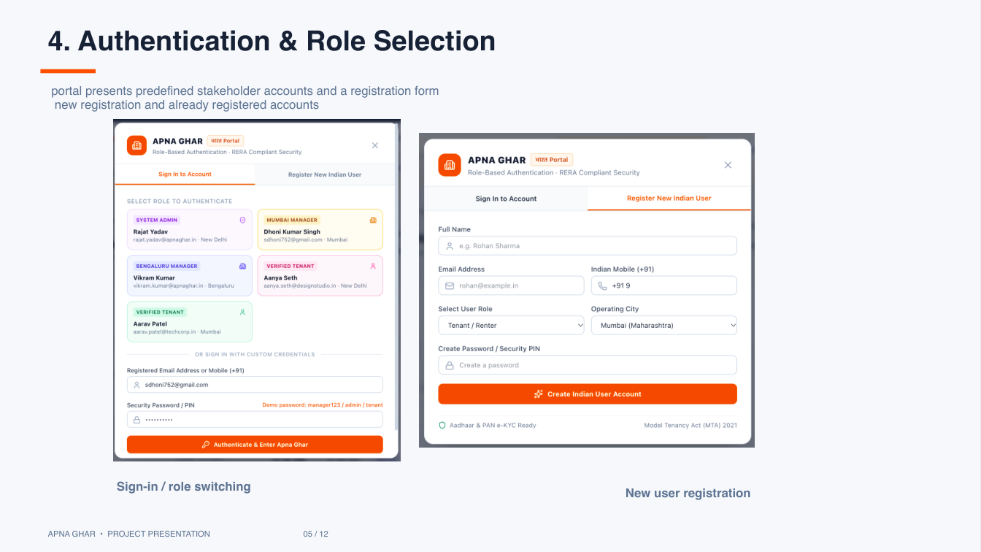
04 • AUTHENTICATION
Authentication & role selection
The portal presents predefined stakeholder accounts and a registration form
Sign-in / role switching
Predefined stakeholder accounts let users explore role-specific dashboards.
New user registration
A registration form represents the entry point for new users.
APNA GHAR • PROJECT PRESENTATION
05 / 12

Slide 6
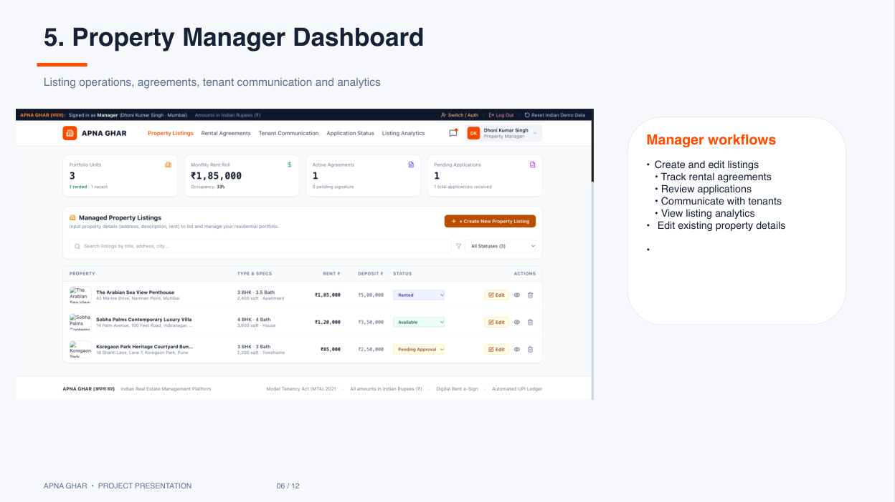
05 • PROPERTY MANAGER
Property Manager dashboard
Listing operations, agreements, tenant communication and analytics
Manager workflows
• Create and edit listings
• Track rental agreements
• Review applications
• Communicate with tenants
• View listing analytics
• Edit existing property details
APNA GHAR • PROJECT PRESENTATION
06 / 12

Slide 7
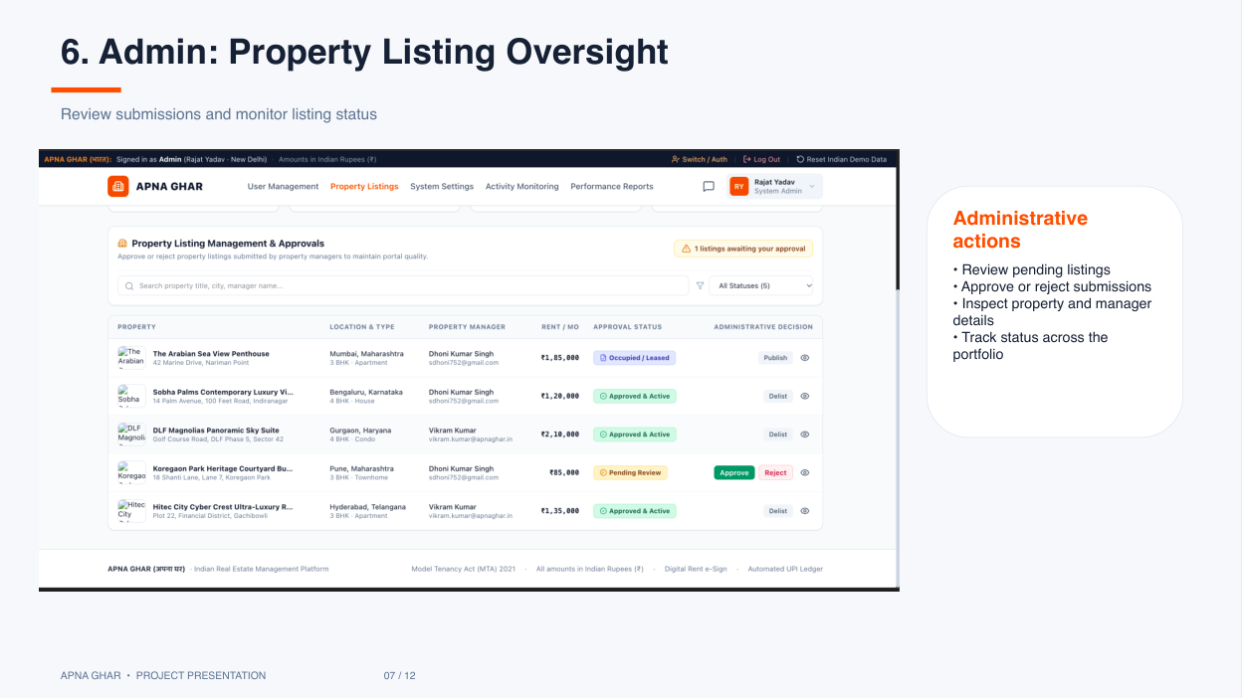
06 • ADMIN OVERSIGHT
Property listing oversight
Review submissions and monitor listing status
Administrative actions
• Review pending listings
• Approve or reject submissions
• Inspect property and manager details
• Track status across the portfolio
APNA GHAR • PROJECT PRESENTATION
07 / 12

Slide 8
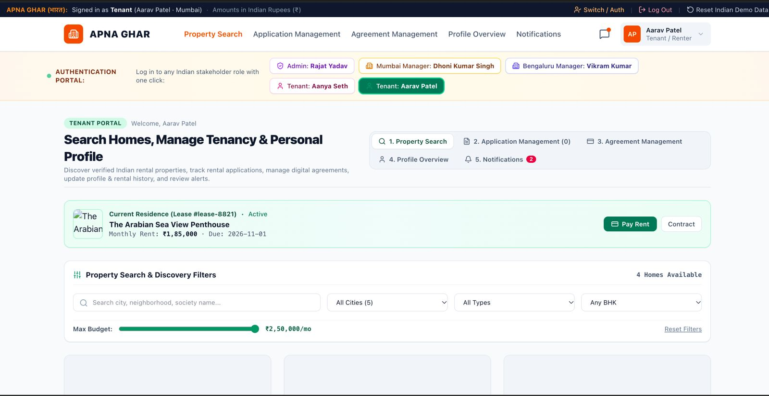
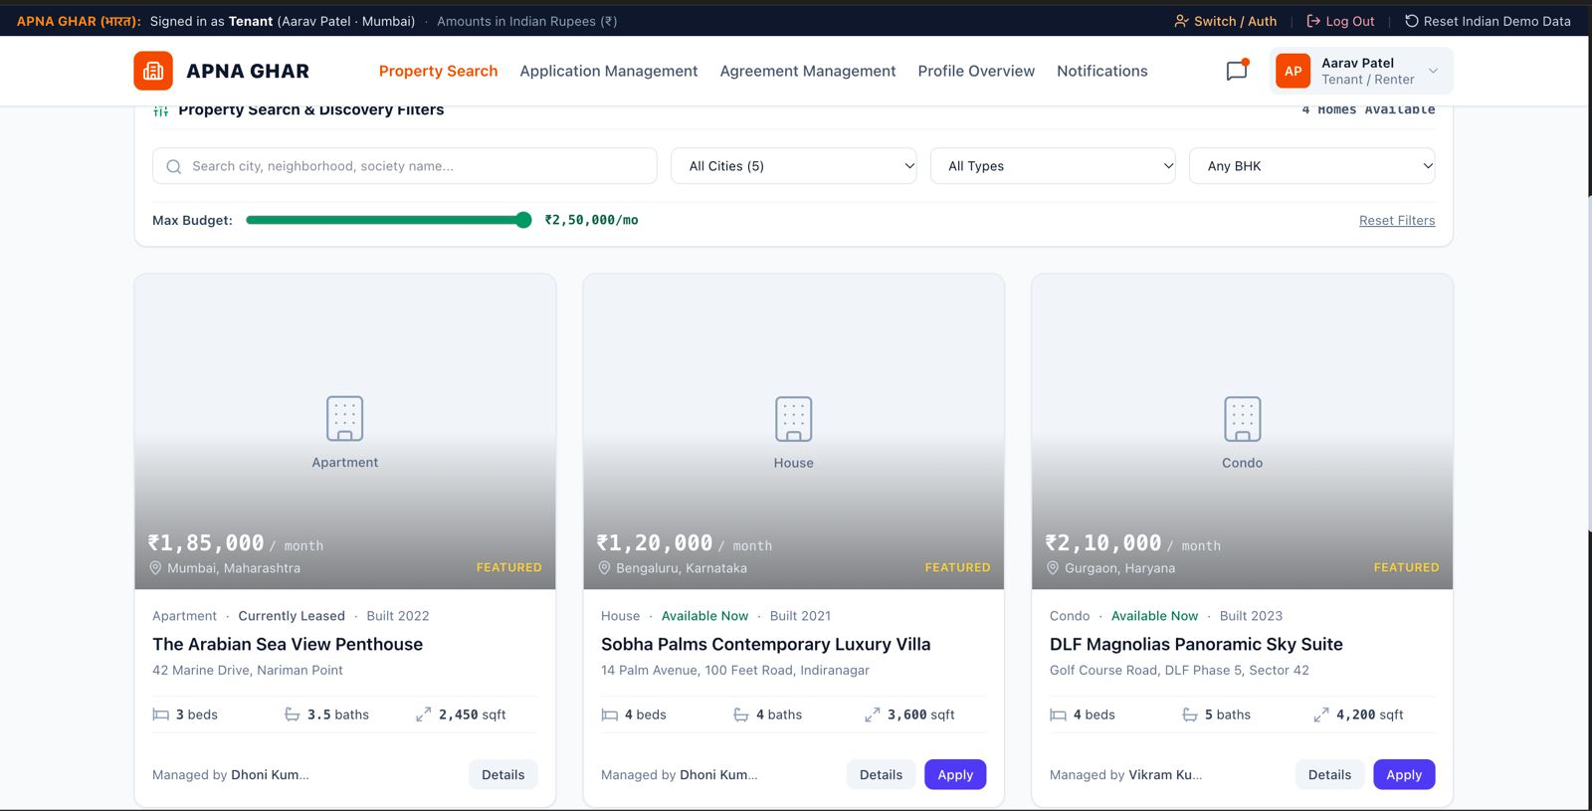
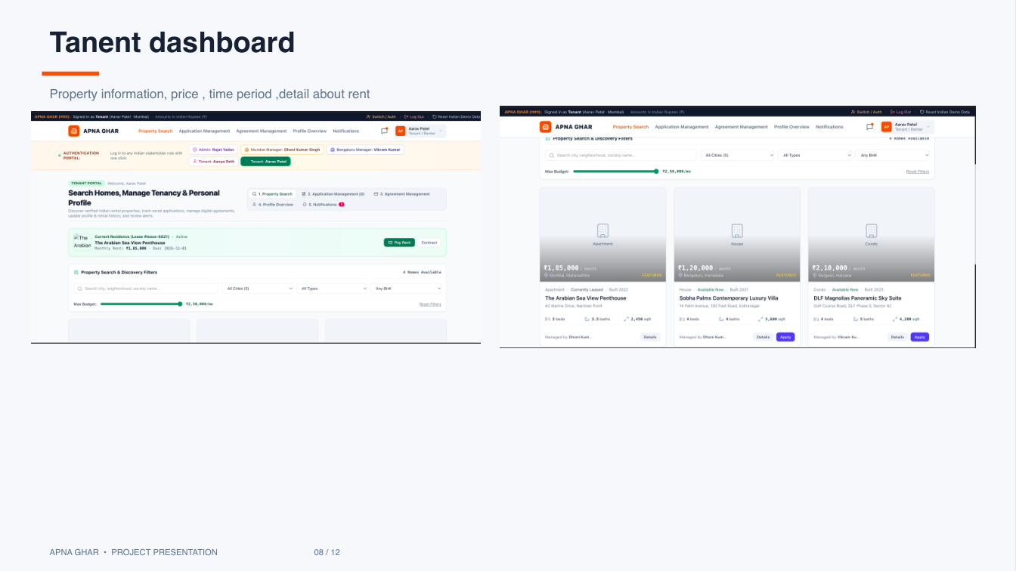
07 • TENANT DASHBOARD
Tenant dashboard
Property information, price, time period and rental details
APNA GHAR • PROJECT PRESENTATION
08 / 12

Slide 9
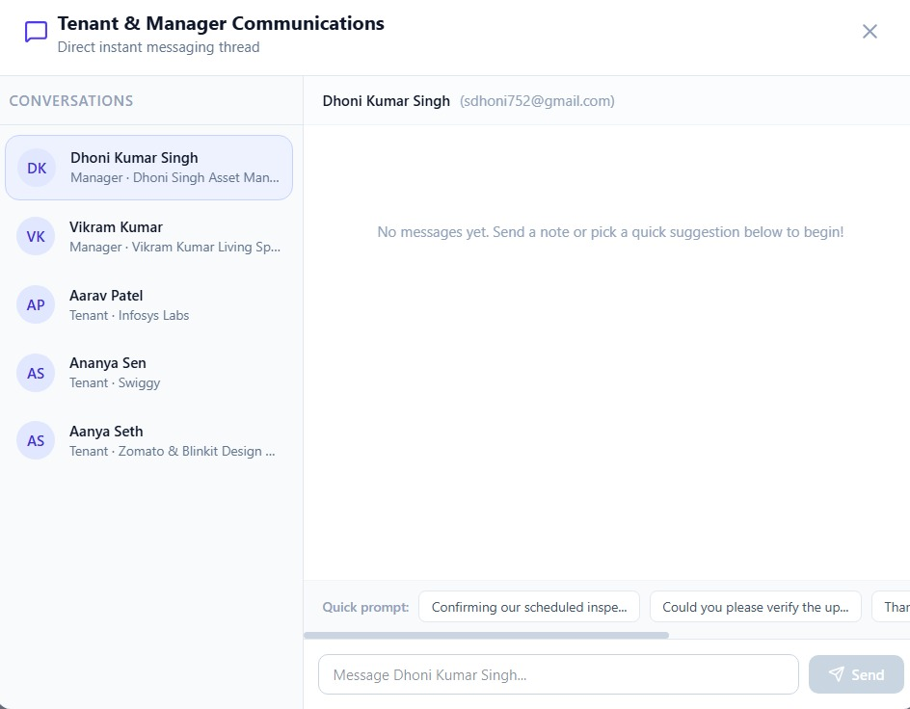
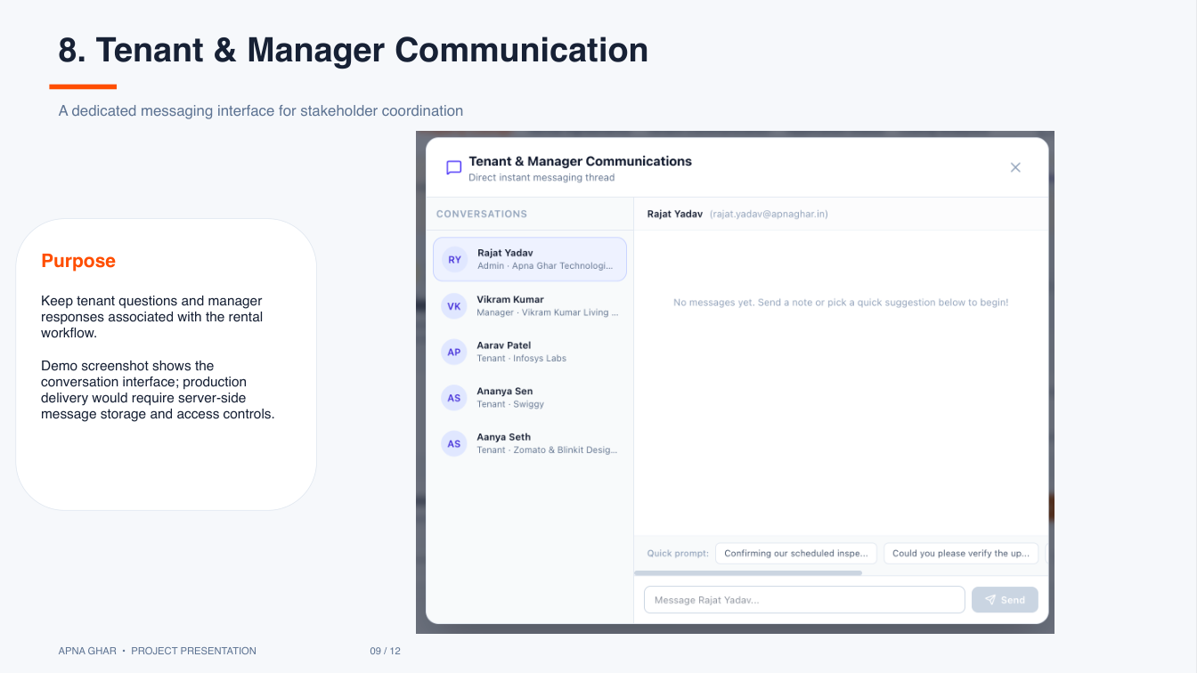
08 • COMMUNICATION
Tenant & Manager communication
A dedicated messaging interface for stakeholder coordination
Purpose
Keep tenant questions and manager responses associated with the rental workflow.
The demo shows the conversation interface; production delivery would require server-side message storage and access controls.
APNA GHAR • PROJECT PRESENTATION
09 / 12

Slide 10
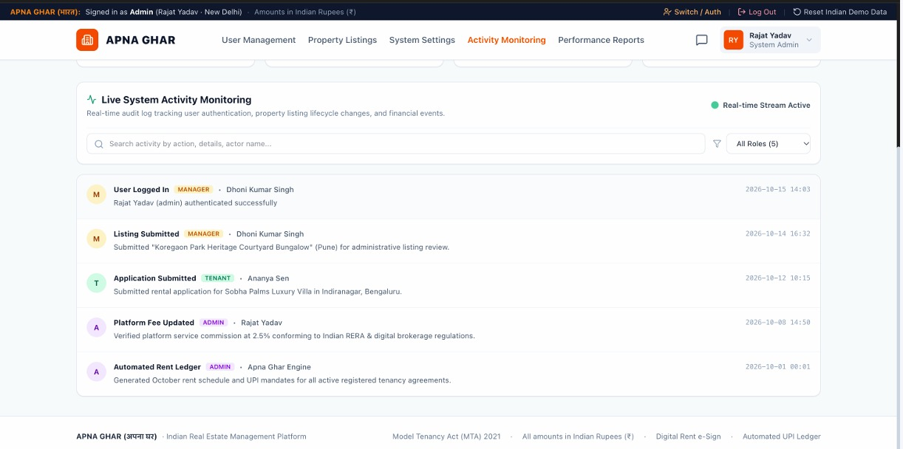
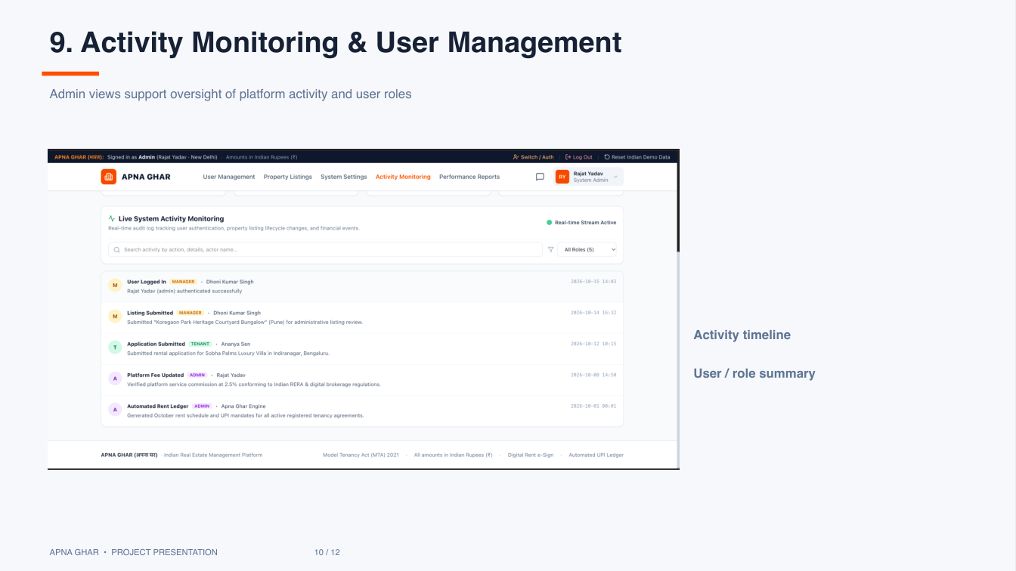
09 • PLATFORM ADMINISTRATION
Activity monitoring & user management
Admin views support oversight of platform activity and user roles
Activity timeline
Review platform events and operational activity.
User / role summary
See users and their assigned stakeholder roles.
APNA GHAR • PROJECT PRESENTATION
10 / 12

Slide 11
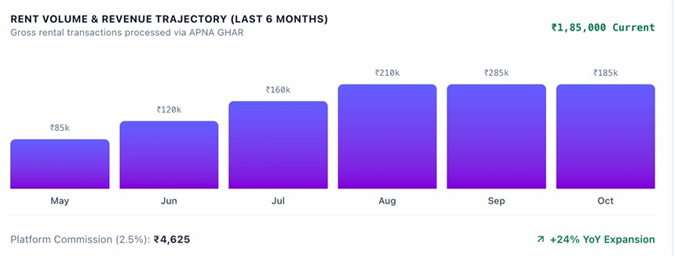
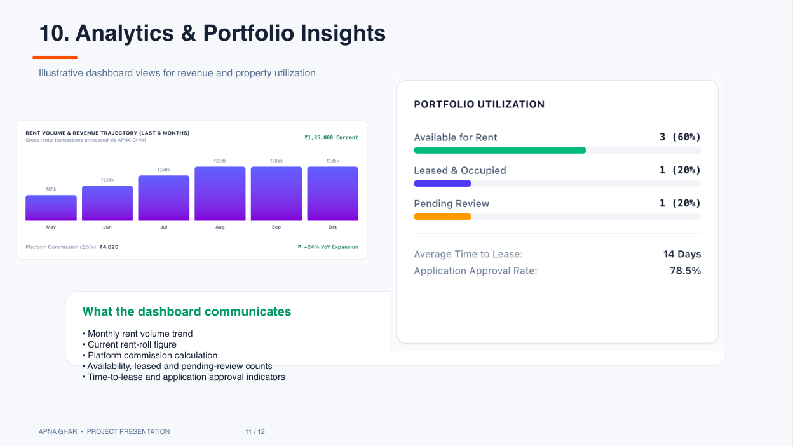
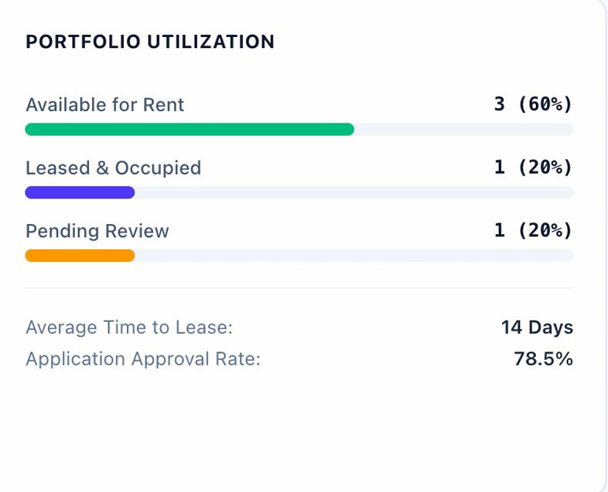
10 • ANALYTICS
Analytics & portfolio insights
Illustrative dashboard views for revenue and property utilization
What the dashboard communicates
• Monthly rent volume trend
• Current rent-roll figure
• Platform commission calculation
• Availability, leased and pending-review counts
• Time-to-lease and application approval indicators
APNA GHAR • PROJECT PRESENTATION
11 / 12

Slide 12
APNA GHAR • CONCLUSION
Conclusion & Future Enhancements
Apna Ghar brings the core property-rental workflow into one role-oriented interface.
Implemented in the prototype
Next development steps
Role dashboards, listing management UI, auth/registration UI, communication UI, admin settings and analytics-style views.
Java backend + Servlets/API, JDBC with MySQL, secure password hashing, persistent user/listing records, real authorization, automated tests and deployment.
TECHNICAL NOTE
This presentation describes the current React/TypeScript prototype. Java, JDBC, Servlets and MySQL should only be claimed after they are implemented and tested.
THANK YOU

